Slide 1
PySpark & AWS: Master Big Data With PySpark and AWS
Hands on Big Data course including in demand industry skills
Muhammad Ahmad

Slide 2
Applications of Spark
Streaming Data
Machine Learning
Batch Data
ETL Pipelines

Slide 3
Why Spark?
Speed
Distributed
Advanced Analytics
Real Time
Powerful Caching
Fault Tolerant
Deployment

Slide 4
HADOOP

Slide 5
HADOOP
Map Reduce
SPARK
YARN
HDFS

Slide 6
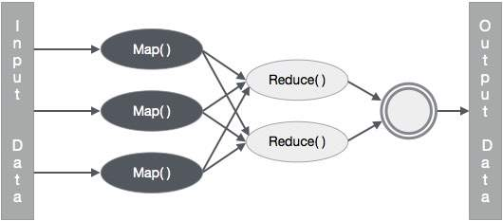

Slide 7
Spark Architecture

Slide 8
Spark Architecture
Workers
Driver Node
Spark Context
Cluster Manager
Workers

Slide 9
Spark Ecosystem

Slide 10
Spark Ecosystem
SPARK SQL
SPARK STREAMING
SPARK MLlib
SPARK GRAPHX
SPARK CORE API
JAVA
SCALA
PYTHON
R

Slide 11
Spark RDDs
RDD is the spark’s core abstraction which stands for Resilient Distributed Dataset
RDD is the immutable distributed collection of objects
Internally spark distributes the data in RDD, to different nodes across the cluster to achieve parallelization.

Slide 12
Transformations and Actions
Transformations create a new RDD from an existing one.
Actions return a value to the driver program after running a computation on the RDD
All transformations in Spark are lazy
Spark only triggers the data flow when there’s a action

Slide 13
Spark Context
SparkContext is the entry point to any spark functionality. When we run any Spark application, a driver program starts, which has the main function and your SparkContext gets initiated here. The driver program then runs the operations inside the executors on worker nodes.
SparkContext uses Py4J to launch a JVM and creates a JavaSparkContext. By default, PySpark has SparkContext available as ‘sc’, so creating a new SparkContext won't work

Slide 14
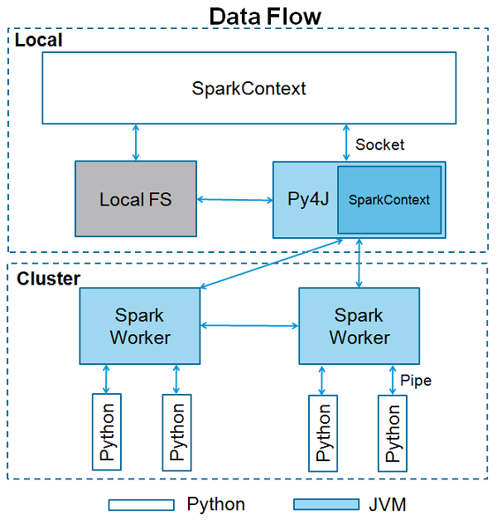

Slide 15
SparkConf
To run a Spark application on the local/cluster, you need to set a few configurations and parameters, this is what SparkConf helps with. It provides configurations to run a Spark application
Following are some of the most commonly used attributes of SparkConf −
set(key, value) − To set a configuration property.
setMaster(value) − To set the master URL.
setAppName(value) − To set an application name.
get(key, defaultValue=None) − To get a configuration value of a key.
setSparkHome(value) − To set Spark installation path on worker nodes

Slide 16
map()
Map is used as a maper of data from one state to other
It will create a new RDD
rdd.map(lambda x: x.split())

Slide 17
QUIZ

Slide 18
QUIZ
For the quiz you’ll be using this input file
Hi how are you?
Hope you are doing
great
Read this file in the RDD
Write a mapper that will provide the length of each word in the following format
[ [2, 3, 3, 4], [4, 3, 3, 5], [5] ]

Slide 19
QUIZ SOLUTION

Slide 20
flatMap()
Flat Map is used as a maper of data and explodes data before final output
It will create a new RDD
rdd.flatMap(lambda x: x.split())

Slide 21
filter()
Filter is used to remove the elements from the RDD
It will create a new RDD
rdd.filter(lambda x: x != 123)

Slide 22
QUIZ

Slide 23
QUIZ
For the quiz you’ll be using this input file
this mango company animal
cat dog ant mic laptop
chair switch mobile am charger cover
amanda any alarm ant
Read this file in the RDD
Write a filter that will remove all the words that are either starting from a or c from the rdd

Slide 24
QUIZ SOLUTION

Slide 25
distinct()
Distinct is used to get the distinct elements in RDD
It will create a new RDD
rdd.distinct()

Slide 26
groupByKey()
GroupByKey is used to create groups based on Keys in RDD
For groupByKey to work properly the data must be in the format of (k,v), (k,v), (k2,v), (k2,v2)
Example: (“Apple”,1), (“Ball”,1), (“Apple”,1)
It will create a new RDD
rdd.groupByKey()
mapValues(list) are usually used to get the group data

Slide 27
reduceByKey()
ReduceByKey is used to combined data based on Keys in RDD
For reduceByKey to work properly the data must be in the format of (k,v), (k,v), (k2,v), (k2,v2)
Example: (“Apple”,1), (“Ball”,1), (“Apple”,1)
It will create a new RDD
rdd.reduceByKey(lambda x, y: x + y)

Slide 28
QUIZ

Slide 29
QUIZ
For the quiz you’ll be using this input file
this mango company
cat mango ant animal laptop
chair switch mango am charger cover
animalany mango ant laptop laptop
this
Read this file in the RDD
Write a transformation flow that will return the word count of each word present in the file as (key, value) pair

Slide 30
QUIZ SOLUTION

Slide 31
count()
count returns the number of elements in RDD
count is an action
rdd.count()

Slide 32
countByValue()
CountByValue provide how many times each value occur in RDD
countByValue is an action
rdd.countByValue()

Slide 33
saveAsTextFile()
SaveAsTextFile is used to save the RDD in the file
saveAsTextFile is an action
rdd.saveAsTextFile(‘path/to/file/filename.txt’)

Slide 34
RDDs Functions

Slide 35
repartition()
Repartition is used to change the number of partitions in RDD
It will create a new RDD
rdd.repartition(number_of_partitions)

Slide 36
coalesce()
Coalesce is used to decrease the number of partitions in RDD
It will create a new RDD
rdd.coalesce(number_of_partitions)
coalesce is only used to decrease the number of partition

Slide 37
Finding Average

Slide 38
QUIZ

Slide 39
QUIZ
For the quiz you’ll be using this input file
JAN,NY,3.0
JAN,PA,1.0
JAN,NJ,2.0
JAN,CT,4.0
FEB,PA,1.0
Read this file in the RDD
Write a code to calculate the average score in each month

Slide 40
QUIZ SOLUTION

Slide 41
Finding Min and Max

Slide 42
QUIZ

Slide 43
QUIZ
For the quiz you’ll be using this input file
JAN,NY,3.0
JAN,PA,1.0
JAN,NJ,2.0
JAN,CT,4.0
FEB,PA,1.0
Read this file in the RDD
Write a code to calculate the Minimum and Maximum rating given by each city.

Slide 44
QUIZ SOLUTION

Slide 45
Mini Project

Slide 46
Mini Project
For the project you’ll be using this input file StudentData.csv that has following columns
age,gender,name,course,roll,marks,email
Read this file in the RDD

Slide 47
Mini Project

Slide 48
Mini Project
Perform the following analytics on the data
Show the number of students in the file.
Show the total marks achieved by Female and Male students
Show the total number of students that have passed and failed. 50+ marks are required to pass the course.
Show the total number of students enrolled per course
Show the total marks that students have achieved per course
Show the average marks that students have achieved per course
Show the minimum and maximum marks achieved per course
Show the average age of male and female students

Slide 49
Spark DataFrames

Slide 50
DataFrame
DataFrame is a wrapper on the RDD
A DataFrame is a Dataset organized into named columns
It is conceptually equivalent to a table in a relational database or a data frame in R/Python
DataFrames can be constructed from a wide array of sources such as
Structured data files
Unstructured data files
External databases
Existing RDDs

Slide 51
Creating Dataframe

Slide 52
Schema of Dataframe

Slide 53
Providing Schema of Dataframe

Slide 54
Creating DataFrame from RDD

Slide 55
Select DataFrame Columns

Slide 56
withColumn in DataFrame

Slide 57
withColumnRenamed in DataFrame

Slide 58
filter/where in DataFrame

Slide 59
QUIZ

Slide 60
QUIZ
For the quiz you’ll be using StudentData.csv
Read this file in the DF
Create a new column in the DF for total marks and let the total marks be 120
Create a new column average to calculate the average marks of the student.
(marks / total marks) * 100
Filter out all those students who have achieved more than 80% marks in OOP course and save it in a new DF.
Filter out all those students who have achieved more than 60% marks in Cloud course and save it in a new DF.
Print the names and marks of all the students from the above DFs

Slide 61
QUIZ SOLUTION

Slide 62
Count, Distinct, DropDuplicates
in DataFrame

Slide 63
QUIZ

Slide 64
QUIZ
For the quiz you’ll be using StudentData.csv
Read this file in the DF
Write a code to display all the unique rows for age, gender and course column.

Slide 65
QUIZ SOLUTION

Slide 66
sort/orderBy in DataFrame

Slide 67
QUIZ

Slide 68
QUIZ
For the quiz you’ll be using OfficeData.csv
Read this file in the DF
Create a DF, sorted on bonus in ascending order and show it.
Create a DF, sorted on age and salary in descending and ascending order respectively and show it.
Create a DF sorted on age, bonus and salary in descending, descending and ascending order respectively and show it

Slide 69
QUIZ SOLUTION

Slide 70
groupBy in DataFrame

Slide 71
QUIZ

Slide 72
QUIZ
For the quiz you’ll be using StudentData.csv
Read this file in the DF
Display the total numbers of students enrolled in each course
Display the total number of male and female students enrolled in each course
Display the total marks achieved by each gender in each course
Display the minimum, maximum and average marks achieved in each course by each age group.

Slide 73
QUIZ SOLUTION

Slide 74
QUIZ

Slide 75
QUIZ
For the quiz you’ll be using WordData.txt
Read this file in the DF
Calculate and show the count of each word present in the file

Slide 76
QUIZ SOLUTION

Slide 77
UDFs in DataFrame

Slide 78
QUIZ

Slide 79
QUIZ
For the quiz you’ll be using OfficeData.csv
Read this file in the DF
Create a new column increment and provide the increment to the employees on the following criteria
If the employee is in NY state, his increment would be 10% of salary plus 5% of bonus
If the employee is in CA state, his increment would be 12% of salary plus 3% of bonus

Slide 80
QUIZ SOLUTION

Slide 81
Cache and Persist

Slide 82
Cache and Persist
TRANSFORMATION 1
TRANSFORMATION 2
ACTION 1
ACTION 2
TRANSFORMATION 1
TRANSFORMATION 2
CACHE()
ACTION 1
ACTION 2

Slide 83
DF to RDD

Slide 84
Spark SQL

Slide 85
Writing DataFrame

Slide 86
Mini Project

Slide 87
Mini Project
For the project we’ll be using OfficeDataProject.csv
Read data from the file in the DF and perform following analytics on it.
Print the total number of employees in the company
Print the total number of departments in the company
Print the department names of the company
Print the total number of employees in each department
Print the total number of employees in each state
Print the total number of employees in each state in each department
Print the minimum and maximum salaries in each department and sort salaries in ascending order
Print the names of employees working in NY state under Finance department whose bonuses are greater than the average bonuses of employees in NY state
Raise the salaries $500 of all employees whose age is greater than 45
Create DF of all those employees whose age is greater than 45 and save them in a file

Slide 88
Collaborative filtering

Slide 89
Utility Matrix

Slide 90
Utility Matrix
 | Movie 1 | Movie 2 | Movie 3 | Movie 4
User 1 | 1 | 5 | 4 | N/A
User 2 | N/A | 3 | N/A | 4
User 3 | 2 | N/A | N/A | 4
User 4 | 4 | 4 | 2 | 5

Slide 91
Explicit and Implicit Ratings

Slide 92
Expected Results

Slide 93
Expected Results
UserId | MovieId | Rating
1 | 1 | 4.8
1 | 22 | 5
2 | 12 | 4
2 | 11 | 3.9

Slide 94
Hands On

Slide 95
Dataset Overview

Slide 96
Joining DFs

Slide 97
Create Train and Test Data

Slide 98
ALS model

Slide 99
Hyperparameter tuning and cross validation

Slide 100
Best model and evaluate predictions

Slide 101
Recommendations

Slide 102
Spark Streaming

Slide 103
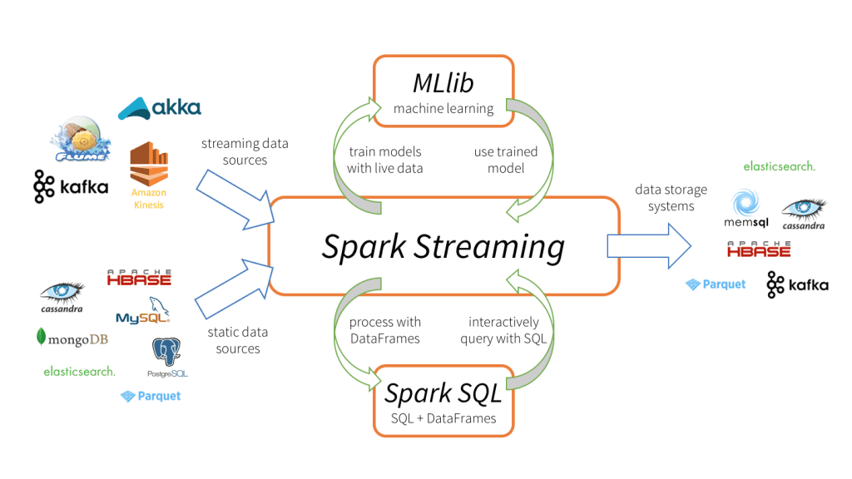

Slide 104
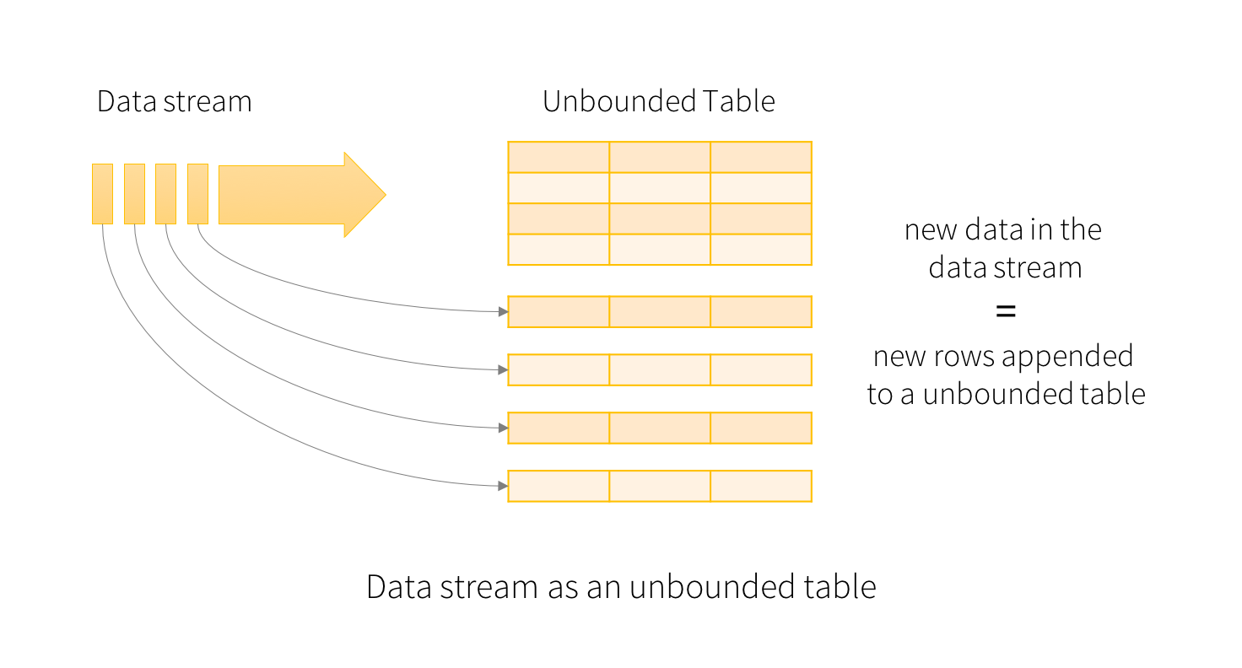

Slide 105
Spark Streaming With RDD

Slide 106
Spark Streaming With DF

Slide 107
ETL Pipeline

Slide 108

csv
Data Extraction
csv
txt
txt
ETL
jdbc
jdbc
…..
Data Load
…..

Slide 109
CSV in DBFS
PySpark on
DataBricks NoteBook
Postgres
Database in AWS RDS
EXT
LD
Transformation

Slide 110
Data Set

Slide 111
Extract

Slide 112
Transform

Slide 113
Installing Postgresql

Slide 114
Load

Slide 115
Project

Slide 116
CDC - Change Data Capture / Replication On Going

Slide 117
Project Architecture

Slide 118
Project Architecture
DMS
RDS -> MySql
Source Endpoint
Destination EndPoint
Temp
HDFS / S3
Lambda
Trigger
Invoke
READ
FINAL
HDFS / S3
READ
WRITE
Glue -> PySpark

